Slide 1
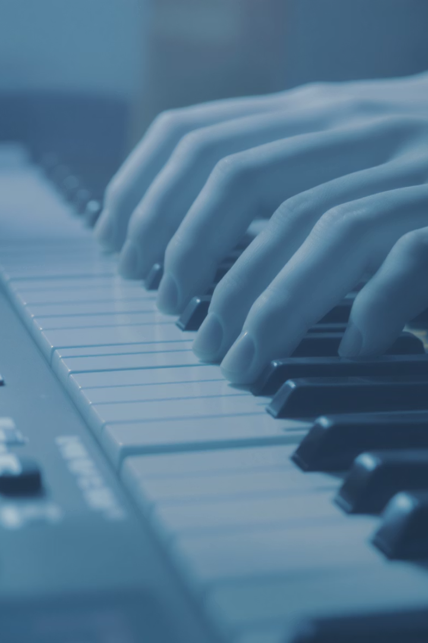
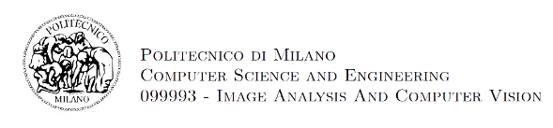
Small Project F12
Visual Reconstruction of Played Music
Computer vision solution to transcribe piano performances from silent video
By Ignacio Bascuñán - 10984708

Slide 2

Project Overview
Challenge
Approach
Output
Detect which piano keys are pressed from silent video
Classical CV pipeline using keyboard rectification and fingertip tracking
Transcribed key presses converted to MIDI files

Slide 3
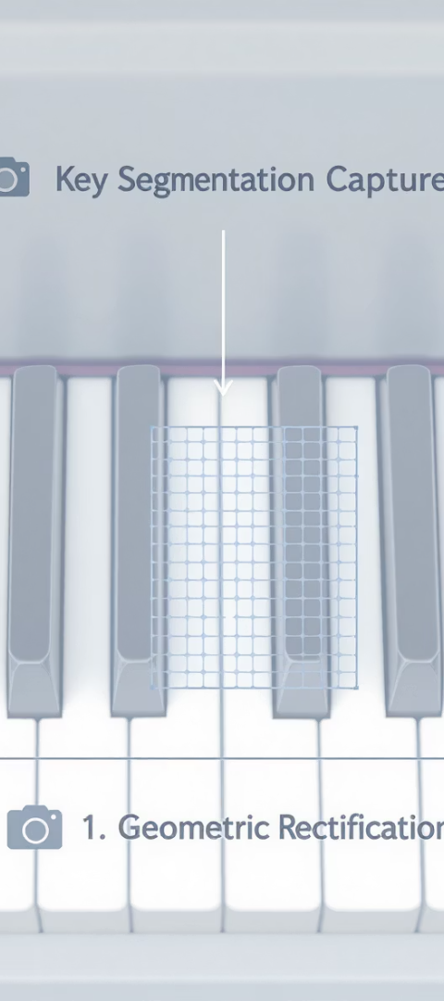

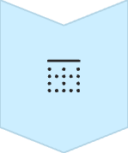

Keyboard Calibration Process
Reference Frame
Capture still image without hands
Geometric Rectification
Extract boundaries using Canny and Hough transforms
Key Segmentation
Map key polygons in rectified domain

Slide 4
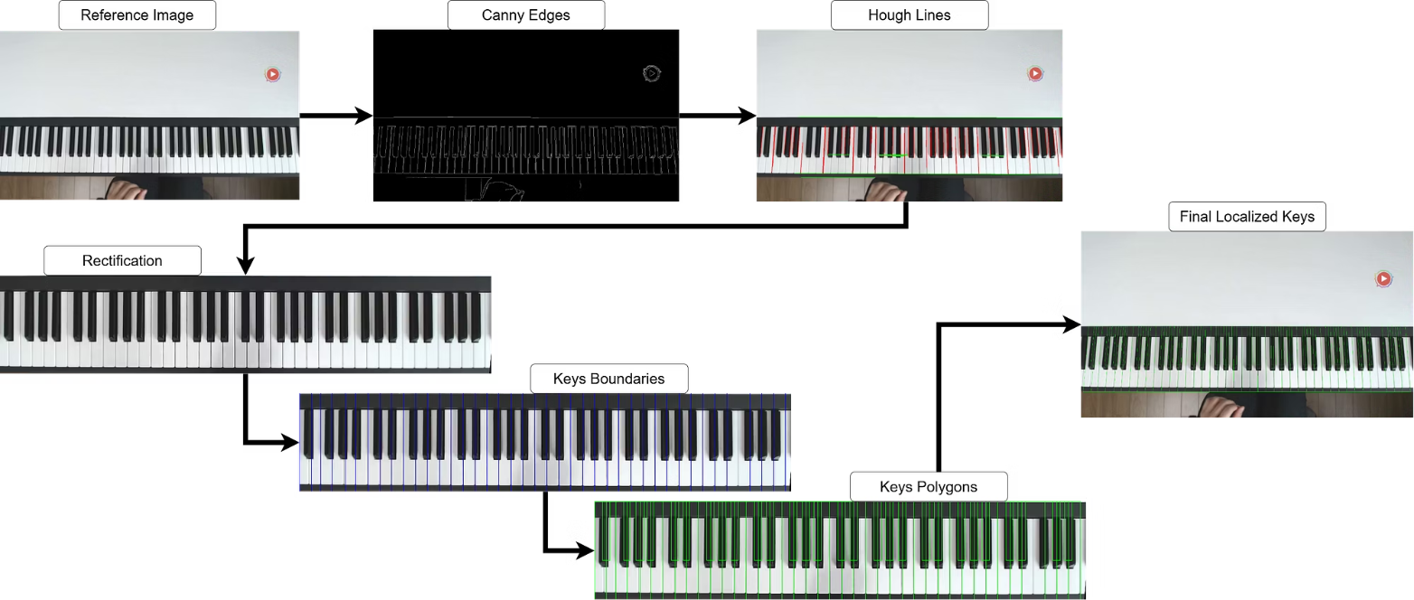
Keyboard Calibration Process

Slide 5
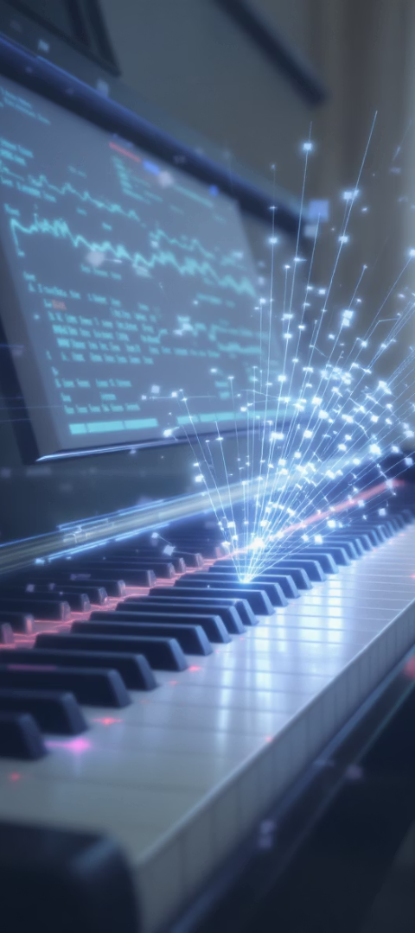
Key-Press Detection Pipeline
Hand Localization
MediaPipe tracks fingertips in real-time
Candidate Mapping
Identify keys potentially touched by fingertips
Photometric Validation
Compare pixel differences to confirm press

Slide 6
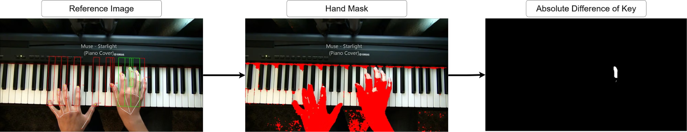
Key-Press Detection Pipeline

Slide 7

Implementation Details
Tech Stack
Key Components
Performance
Python 3.10
Homography mapping
~200ms per frame
OpenCV 4.11
Background subtraction
Real-time hand tracking
MediaPipe 0.10
MIDI synthesis

Slide 8
Experimental Results
7 different videos for test cases
3 human testers
Evaluation Scale
1
Impossible to recognize
2
Some notes and rhythms seem to match the original song
3
The song is recognizable
4
The song not only is recognizable, but is pleasant to hear
5
Just some mistakes were made between the original song and the simulated output

Slide 9
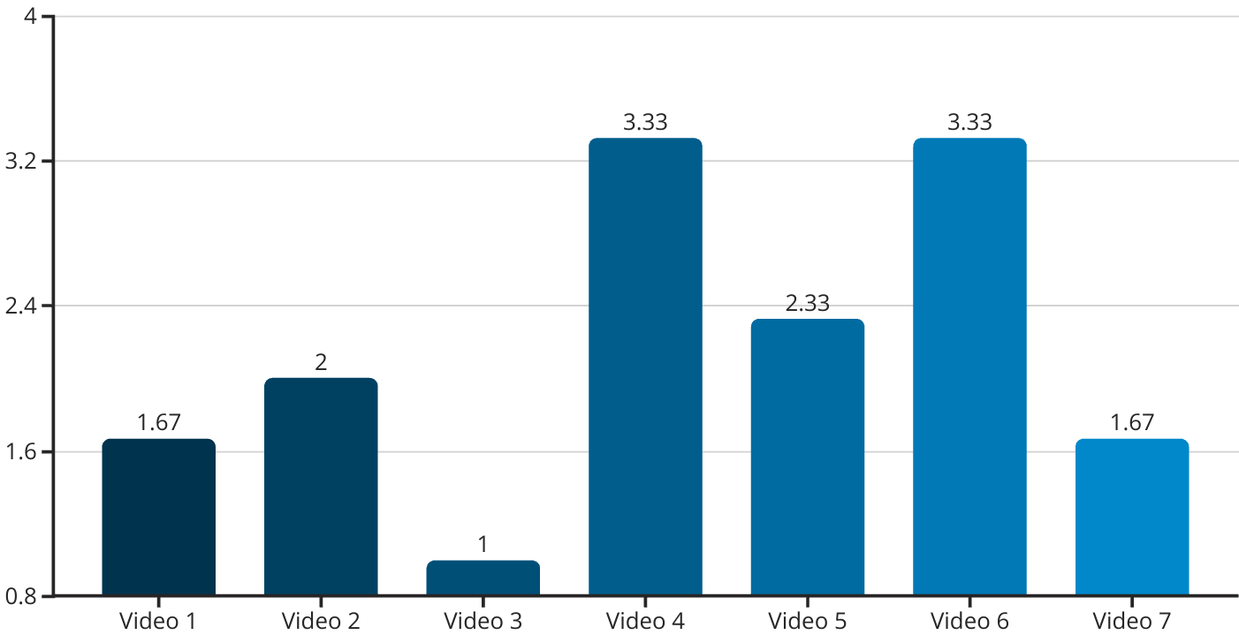
Experimental Results (1 - 5)

Slide 10
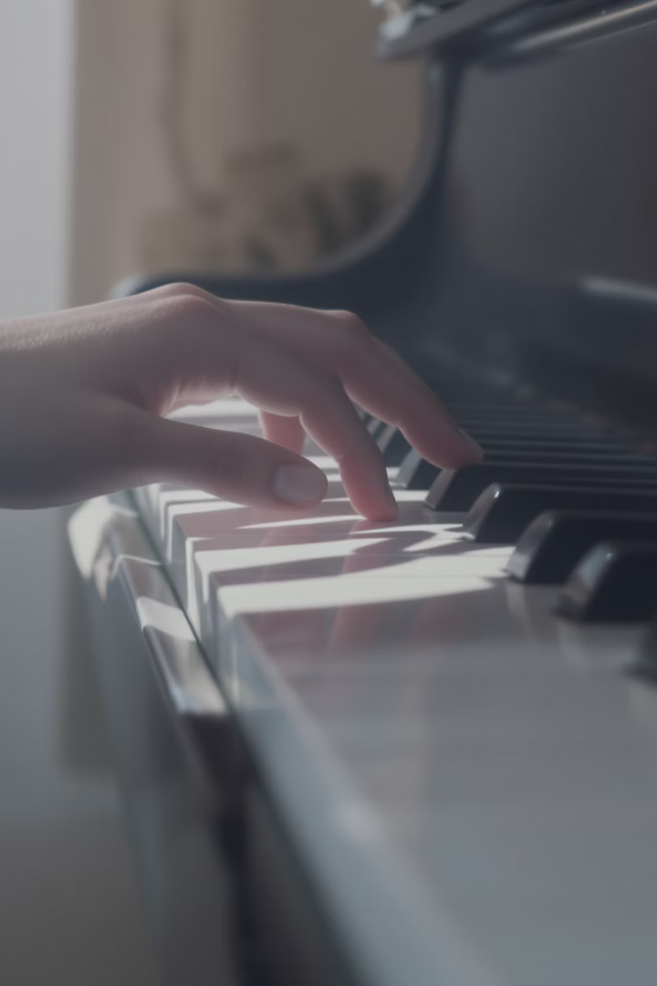




Key Limitations
Lighting Issues
Sensitivity to reflections and shadows
Occlusion Problems
Cannot resolve overlapping fingertips
Black Key Detection
Poor accuracy due to minimal shadow contrast
Parameter Sensitivity
Requires manual calibration per video

Slide 11








Future Directions
Temporal Networks
Multi-cue Fusion
Train on synthetic renderings
Incorporate optical flow analysis
Adaptive Calibration
Self-supervised Learning
Auto-tune parameters per video
Fine-tune to individual performers

Slide 12

Demo: Youtube Video
Original Input
Produced Output
https://www.youtube.com/watch?v=P0kUMfg-dHE

